Slide 1
Onboard Charger – System Overview
EVSBG ADV R&D BLR

Slide 2

Electric Vehicle - Overview

Slide 3
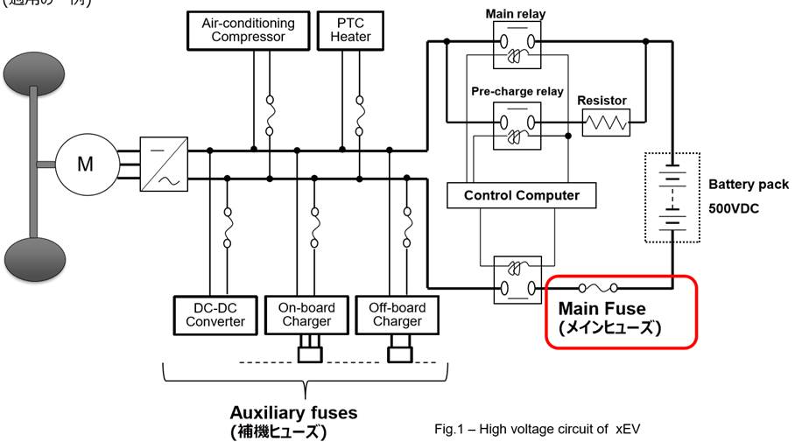

Electric Vehicle - Overview
400V
12 V Battery

Slide 4
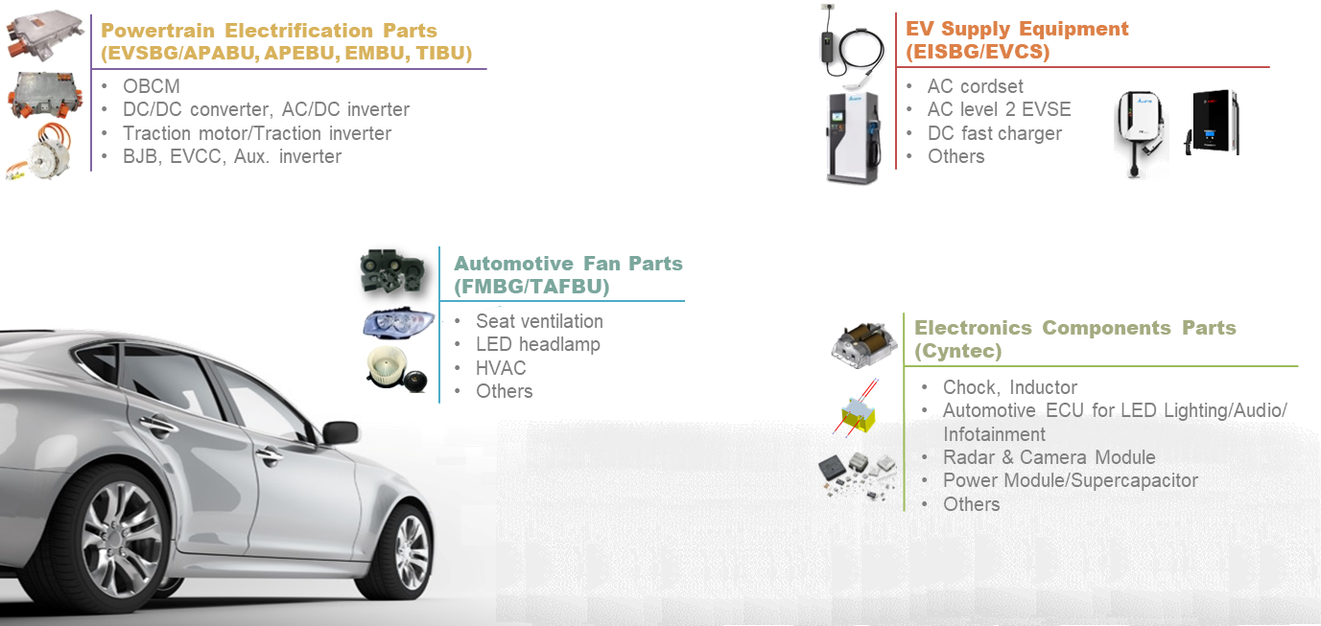
Delta Automotive Product Offering

Slide 5
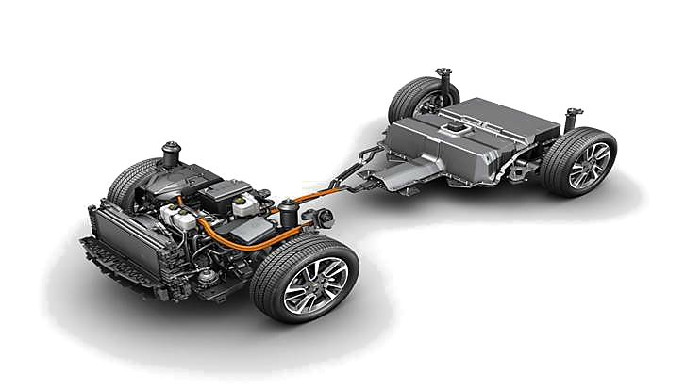
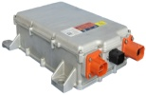
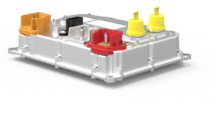
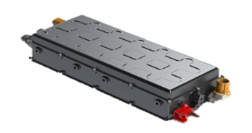
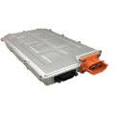
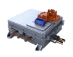
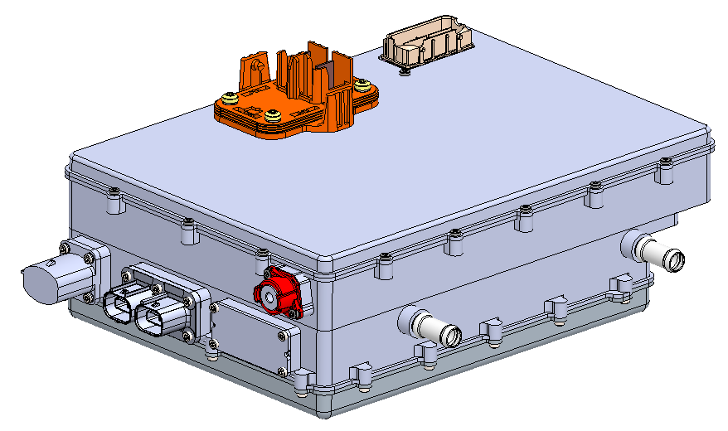
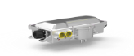
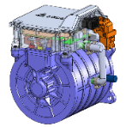
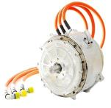
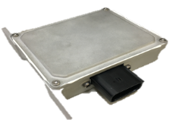
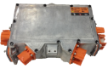
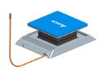
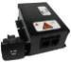
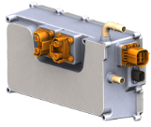
Overview of EVSBG Product Portfolio
OBCM
Bi-dir. OBCM
DCDC
CCU / Combo
Traction Inverter
48V DCDC
Inverter Combo
BJB
Motor + Inverter
Power
Traction Motor
DCGM
EVCC
Wireless Charging
Auxiliary Inverter
On Board Generator (OBG)
Traction
DCGM: Digital Communication Gateway Module, EVCC: Electric Vehicle Communication Controller

Slide 6
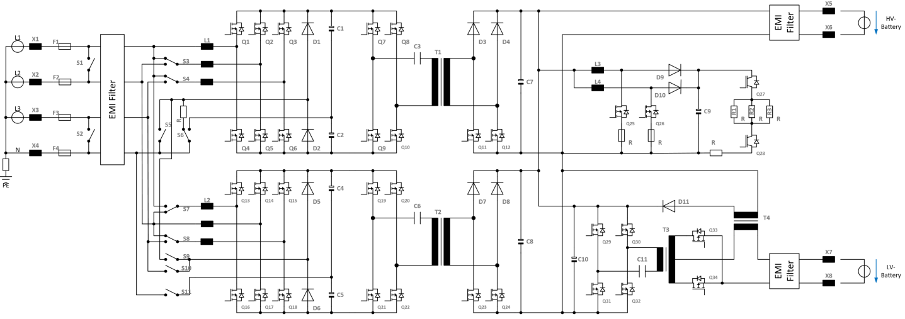
Electrical Concept – Power Path
Heater DC/DC
HV Battery
AC Input
Fuses, Protection and EMI
LV Battery
Switch Matrix
2x 6-switch PFC
2x HV DC/DC
LV DC/DC

Slide 7
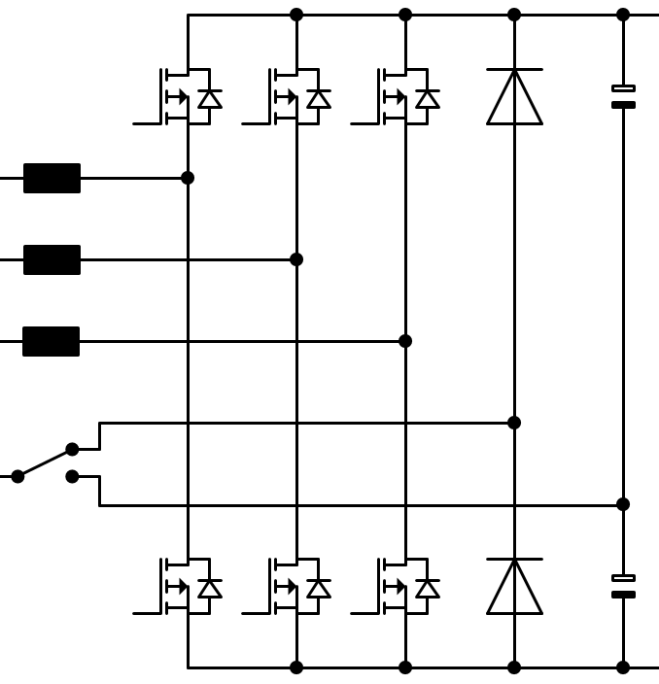
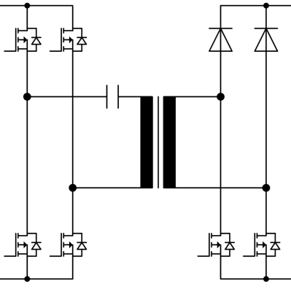
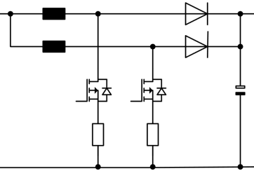
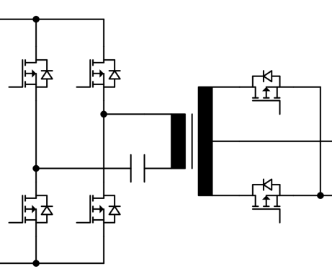
Electrical Concept - Functions
PFC AC/DC
Converts AC to constant DC
HV DC/DC
Galvanic insulation
Converts constant DC to Variable DC to charge the HV battery
Heater DC/DC
Prevents coolant from freezing
LV DC/DC
Galvanic insulation
Charges the LV battery and powers the Auxilliary Loads

Slide 8
Electrical Design - All Block diagram

Slide 9
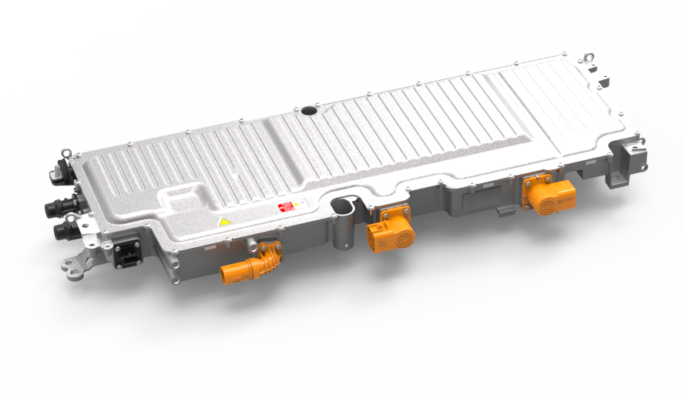
IPB 11KW Housing
Cover
(deep drawn)
fulfills 1.2kN requirement
Sealing
(FIPG)
12V-Connector +
12V-Connector -
AC-Connector
Rosenberger HVR60+
Coolant-Connector Quick NW 16
Optional 2nd AC-Connector
Rosenberger HVR60+
Signal-Connector
HV-DC-Connector
Hirschmann
HPS40-2

Slide 10
Microcontroller and Communication
HVDC-
AC-N
AC
Input
Transformer
HVDC
Output
COM/HVDC
Infineon
SAK-TC364DP
HVAC
Infineon
SAK-TC364DP
LLC
SBC
Isolator
SBC
Heater
CAN Transceiver
+ Isolator
Transformer
LV-
CAN Transceiver
+ Isolator
DCDC
Infineon
SAK-TC213L
LVDC
Output
U_KL30
SBC
I_KL30
KL30c
KL31-
2x CAN Transceiver
+ Isolator
Debug CAN
Hybrid CAN

Slide 11
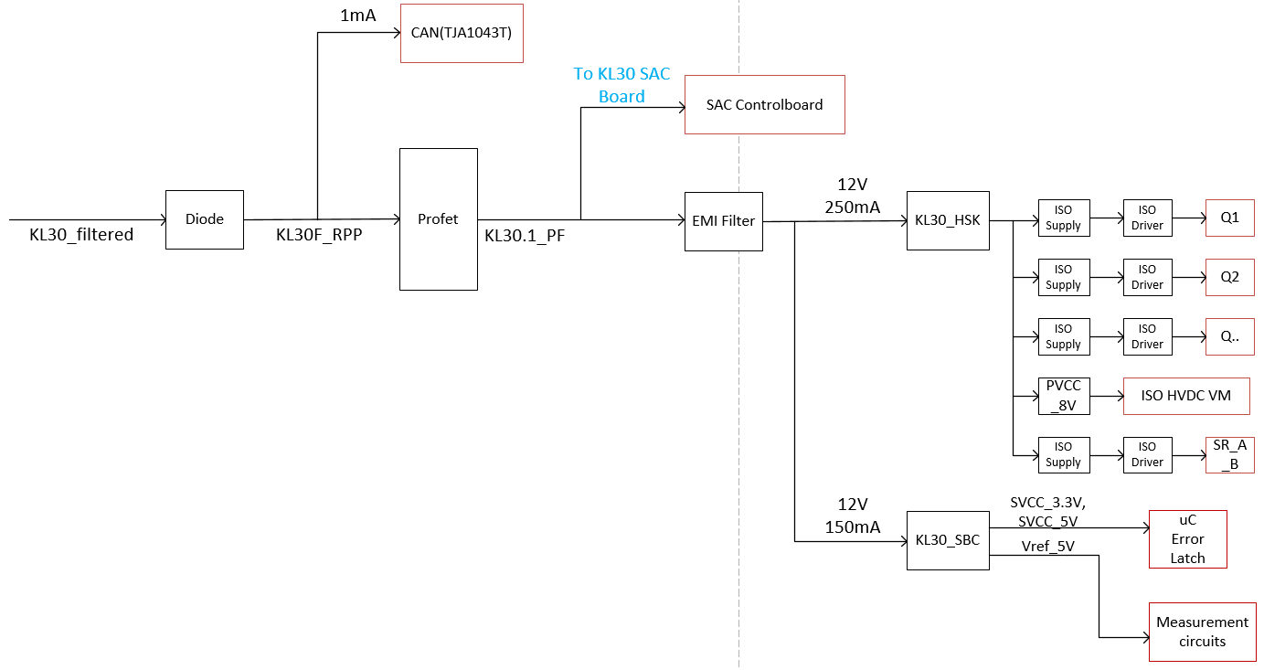
Control and Communication – Auxiliary supply
Auxiliary supply concept for LVDCDC
A system basis chip (SBC) is an integrated circuit that includes various functions of automotive electronic control units (ECU) on a single die.
PROFET™ family (PROtected FET) incorporates a broad range of smart features, like diagnosis and protection.

Slide 12
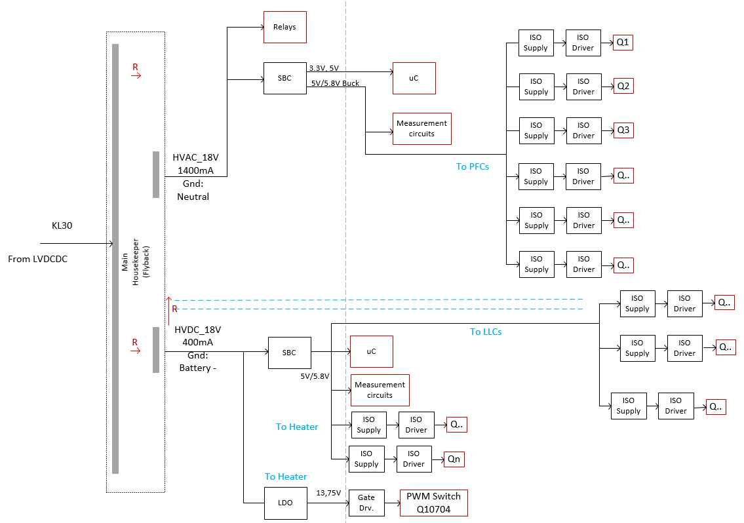
Control and Communication – Auxiliary supply
Auxiliary supply concept for OBC

Slide 13
Integrated HW/SW-Model & Virtual Test Bench
Integrated Model -Virtual Test Bench
1
SW Modules
Digital control modules
→ Focus on code generation
Target specific control modules
→ Focus on detailed simulation
HW Modules
Control circuits
→ Sensors, Protection, Comm.
Power circuits
→ Filters, topology modules
Testing Device Library
Models of test equipment
→ Focus on pre-test and debugging
→ Virtual integration tests
Charger Unit
2
1
2
3
3

Slide 14
Smarter. Greener. Together.

